Slide 1
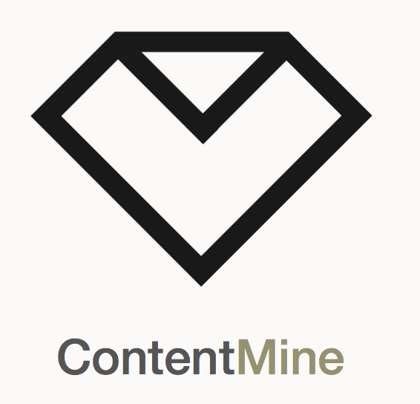




The Language of Materials
Peter Murray-Rust
University of Cambridge
with
Ayush Garg, Anuv Chakraborty, Shweata N Hegde
MADICES2022, 2022-02-07
All code is Open; All work is Open Notebook Science;
Goal: automatically make current literature semantic
HACK PROJECTS “Rough consensus and running code”
pm286@cam.ac.uk
peter@contentmine.org
Images from ContentMine CC BY and Wikimedia CC BY-SA

Slide 2
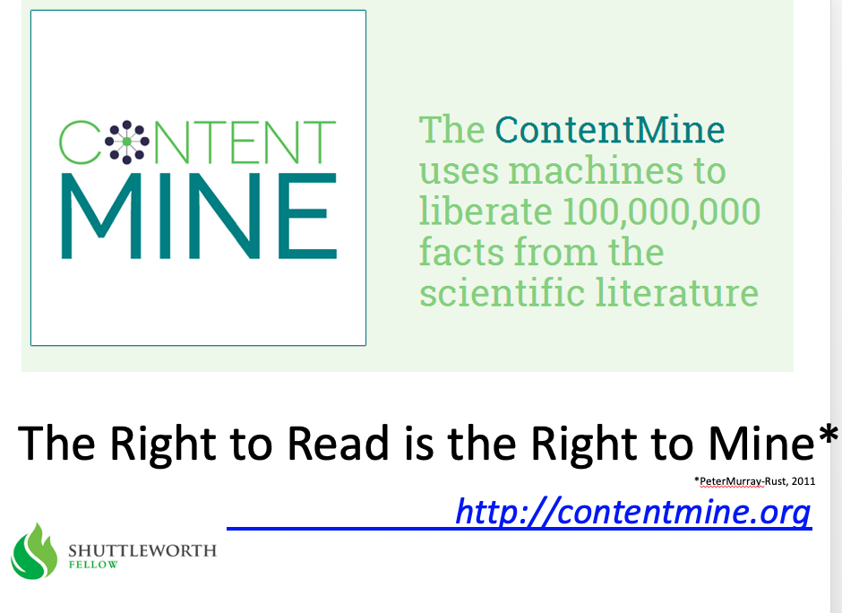
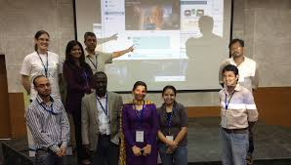
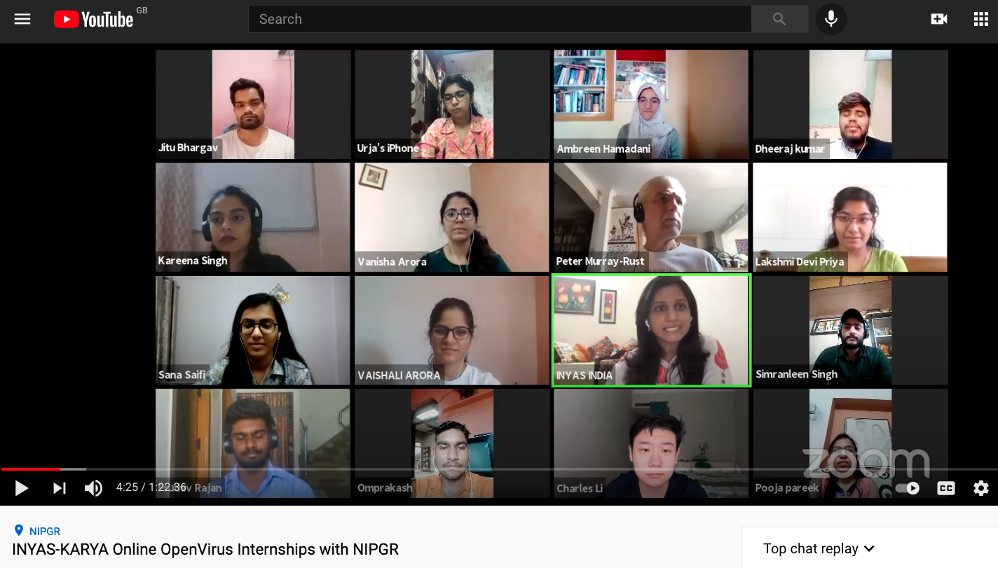
2013
TIGR2ESS 2019 Delhi Food Security FEB 2019
Gita Yadav + colleagues
Delhi 2014
NIPGR: Developed Virtually over 6 weeks!
OpenVirus
Priya and Kareena interns
JUNE 2020
INYAS – KARYA-DBT
CEVOpen 2021/2
https://www.youtube.com/watch?v=XiTngk-POm8&ab_channel=INYASYouTube
Aug 2020
2020-06-01

Slide 3
The language of materials - first steps
What names we use? docanalysis
What do they mean? Wikidata
What objects do they describe?
What are their values? Image Extraction
Use domain-specific representations and tools
Linking can be done with HTML, RDF, etc.
Object 1
Object2
Process,
Relationship,
Sequence,

Slide 4
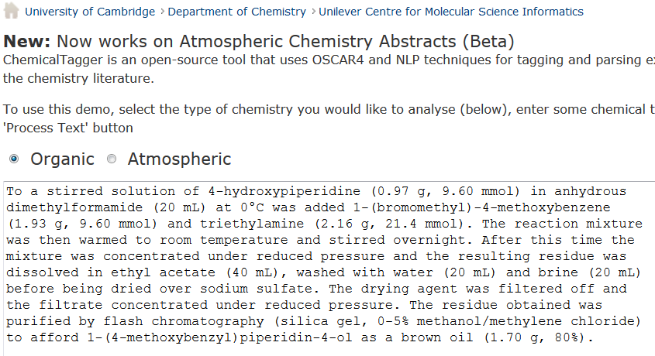
http://chemicaltagger.ch.cam.ac.uk/
Lezan Hawizy
Typical
Typical chemical synthesis
This contains several small annotating and parsing ontologies

Slide 5
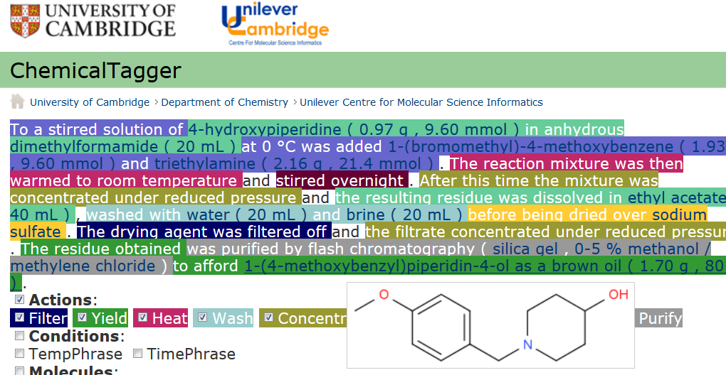
Automatic semantic markup of chemistry
Could be used for analytical, crystallization, etc.

Slide 6
Materials discourse
SCIENTIFIC REPORTS | 4 : 5694 | DOI: 10.1038/srep05694
The syntheses of NiO and LiNi 0.4Mn 0.4Co 0.18Ti 0.02O 2 (NMC) were performed according to previously developed protocols 56. In short, NiO was synthesized using a solvothermal method aided with an alcohol pseudo-supercritical drying technique. NMC was synthesized using a co-precipitation method followed by high-temperature annealing with LiOH. 2032 Coin cells were fabricated using composites of NiO or NMC as working electrodes and lithium metal foils as counter electrodes. The NiO working electrodes were composed of 80 wt.% active material, 10 wt.% polyvinylidene fluoride (Kureha Chemical Ind. Co. Ltd) and 10 wt.% acetylene carbon black (Denka, 50% compressed) and loadings were typically 12 mg/cm 2 of active material. To make the electrodes, these solids were mixed into N-methyl-2-pyrrolidinone and the resulting slurry cast onto copper current collectors and dried. NMC working electrodes were prepared similarly and contained 84 wt.% active material, 8 wt.% polyvinylidene fluoride, 4 wt.% acetylene carbon black and 4 wt.% SFG-6 synthetic graphite on carbon-coated aluminum current collectors, with typical active material loadings of 67 mg/cm 2. The coin cells were assembled in a helium-filled glove box using Celgard 2400 separators and 1 M LiPF6 electrolyte in 1:2 w/w ethylene carbonate/dimethyl carbonate (Ferro Corporation). Battery testing was performed on a computer controlled VMP3 potentiostat/galvanostat (BioLogic). NiO and NMC electrodes were cycled at C/2 and C/20 rates, respectively. 1C was defined as fully discharging or charging an electrode in 1 h, corresponding to specific current densities of 718 mA/g and 280 mA/g for NiO and NMC materials, respectively.
Cut-n-paste into
http://chemicaltagger.ch.cam.ac.uk/
Written ca 2007 by Lezan Hawizy
Daniel Lowe wrote OPSIN (name to structure)

Slide 7
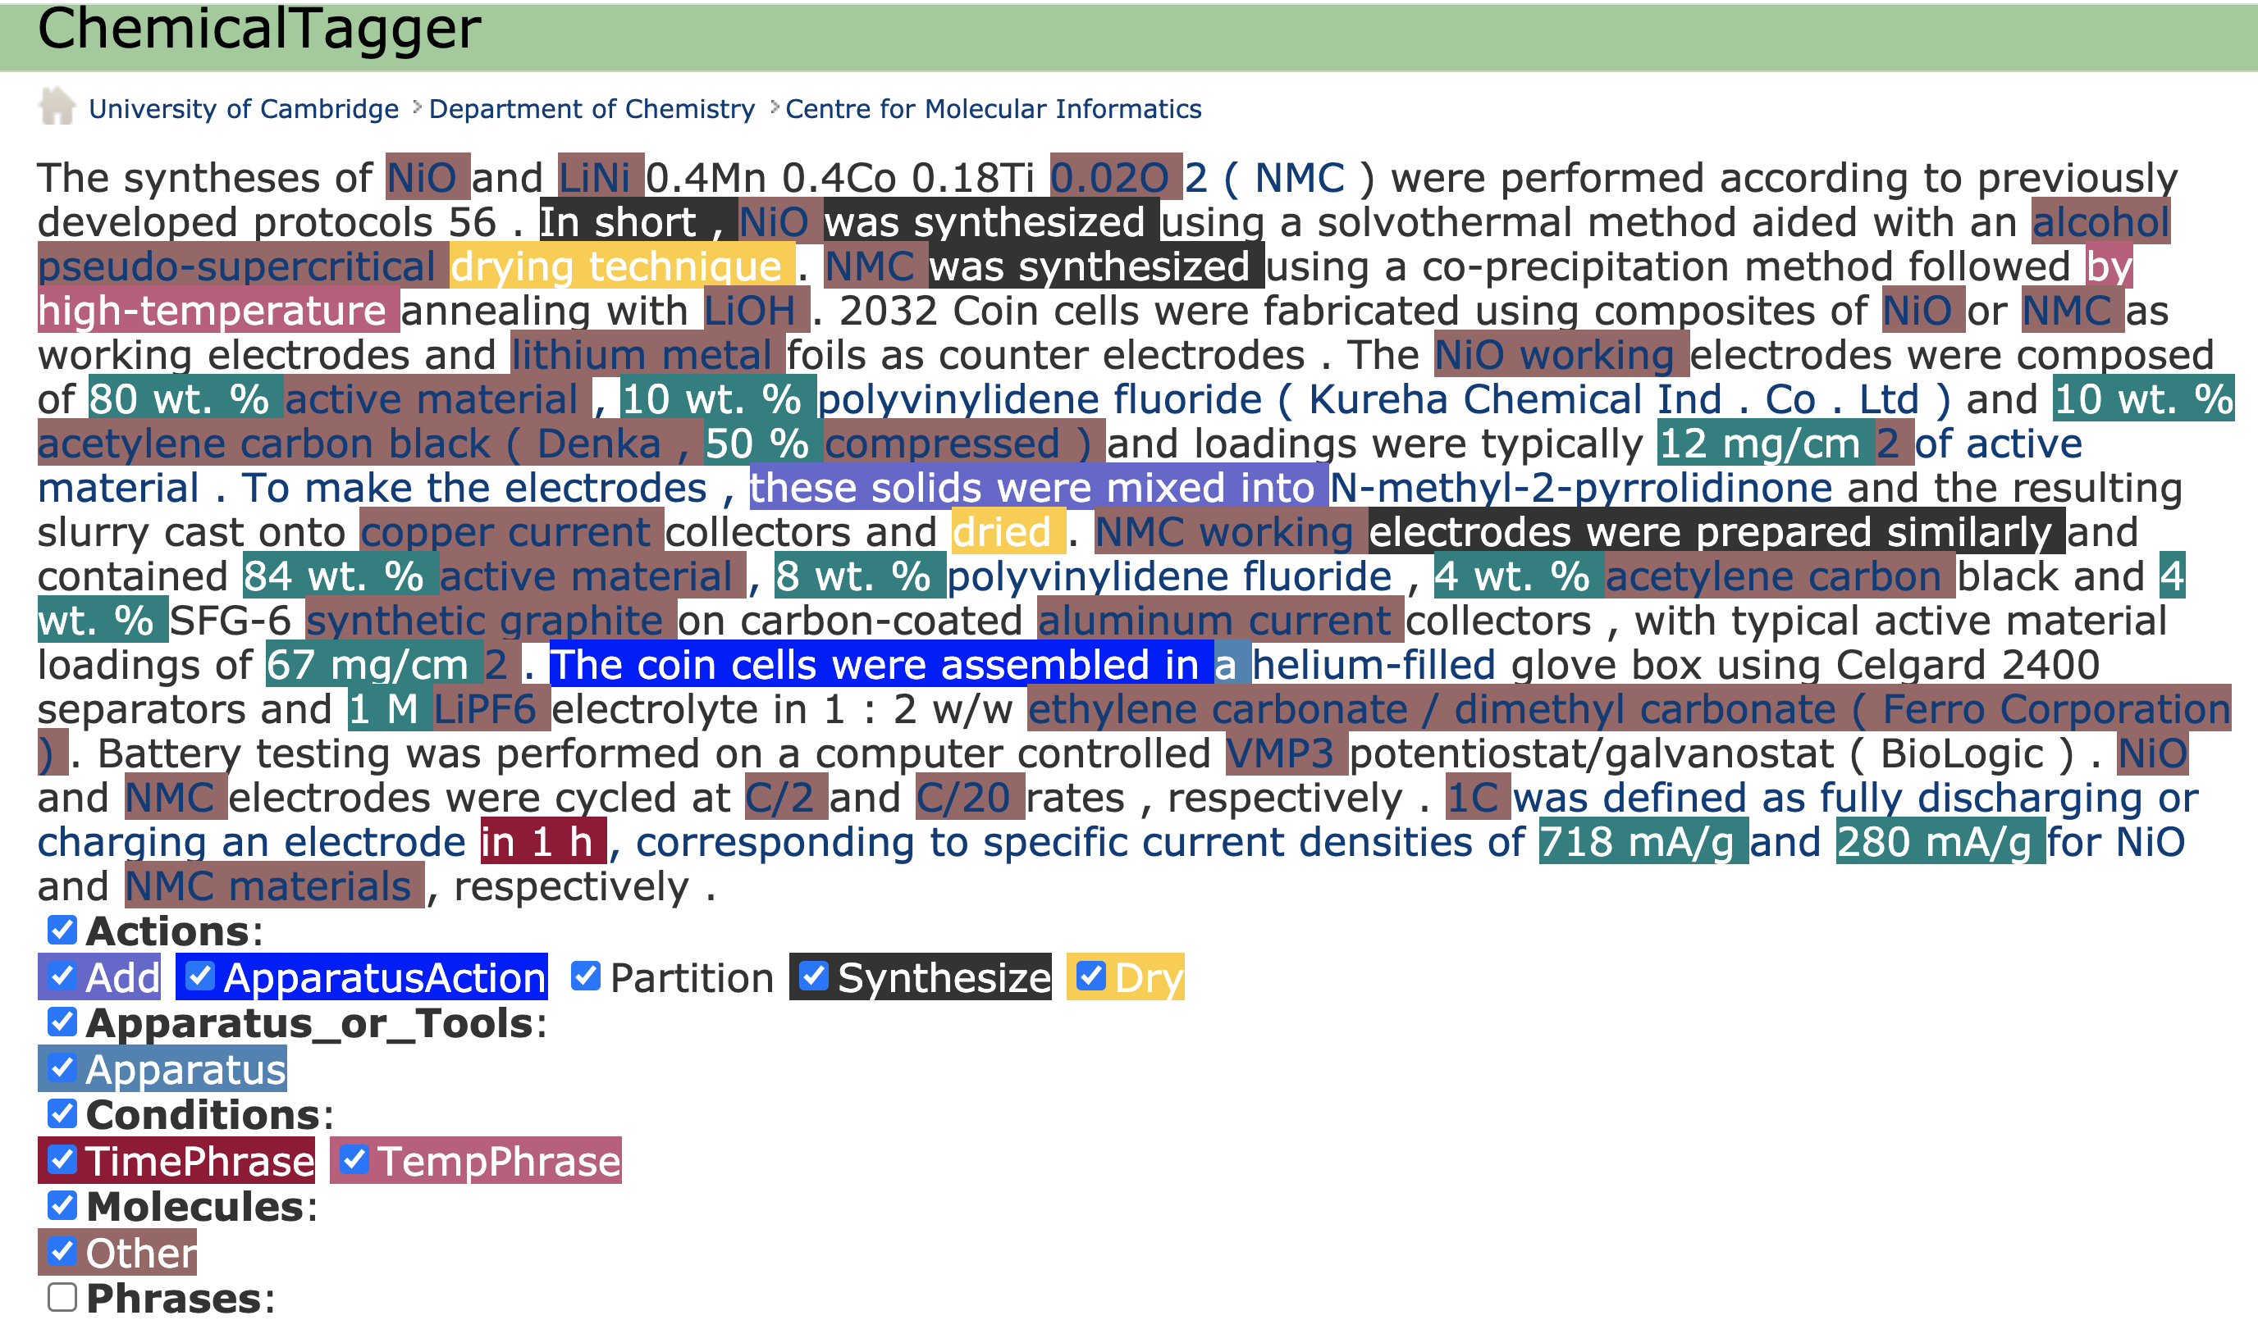
ChemicalTagger “out of the box” on Materials discourse
HACK PROJECT: dictionaries for unextracted terms

Slide 8
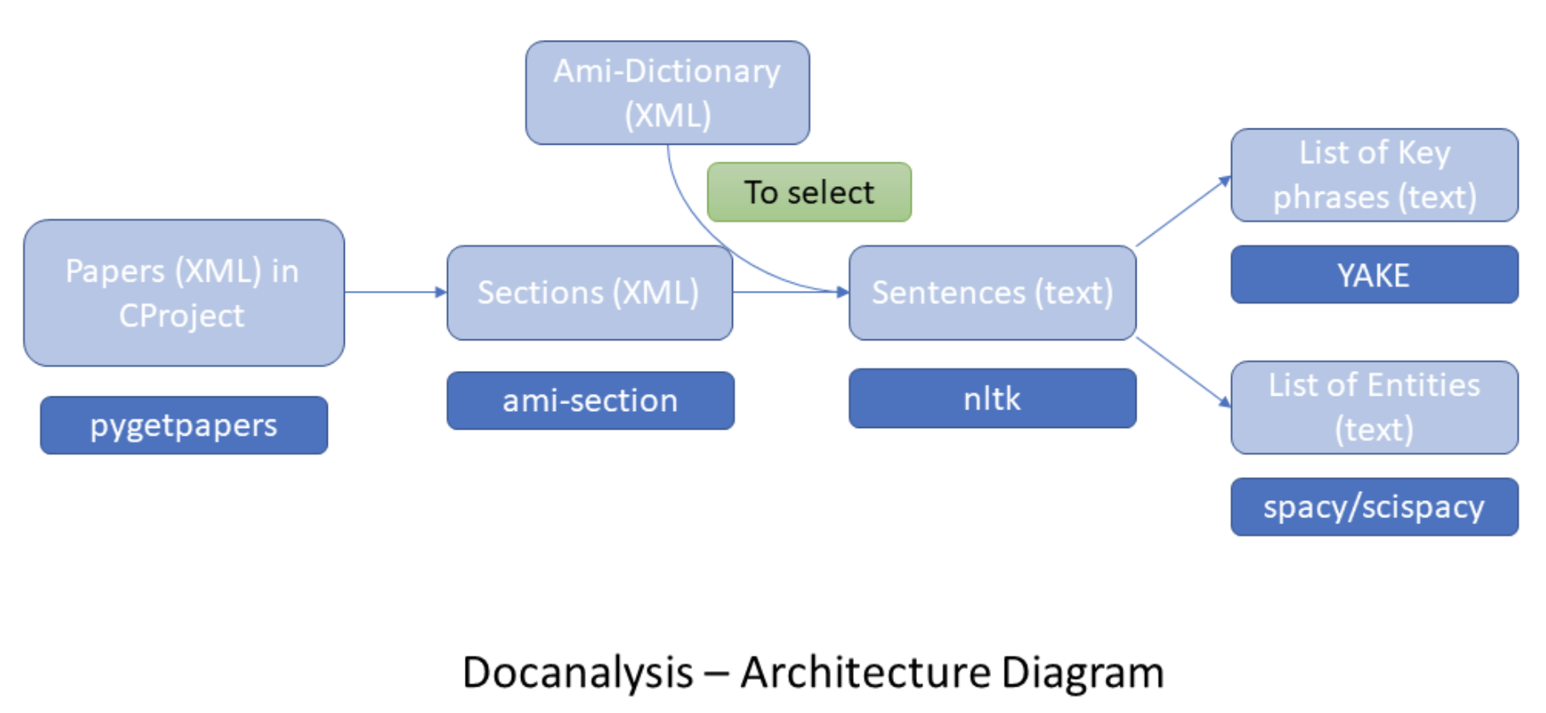
pygetpapers + docanalysis
60 papers/minute (depending on download/server_politeness)
Shweata Hegde
Ayush Garg

Slide 9
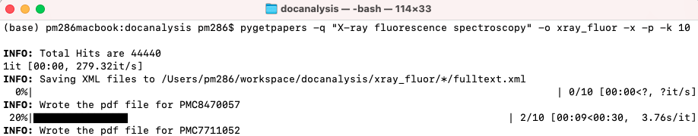
pygetpapers search for “X-ray fluorescence spectroscopy
HACK PROJECT: pygetpapers + EuropePMC
Ayush Garg

Slide 10
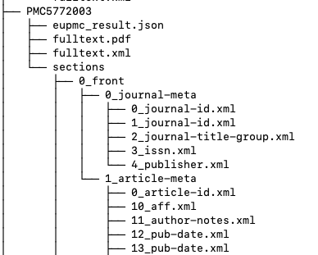
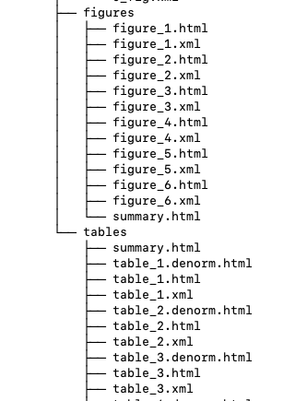
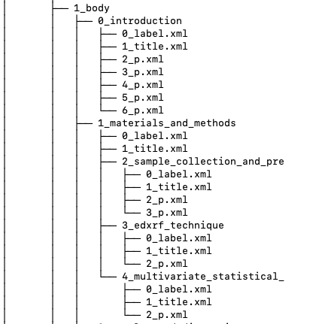
Components of article automatically extracted
Metadata
Figure Captions
Main text
Tables
docanalysis: Shweata Hegde

Slide 11
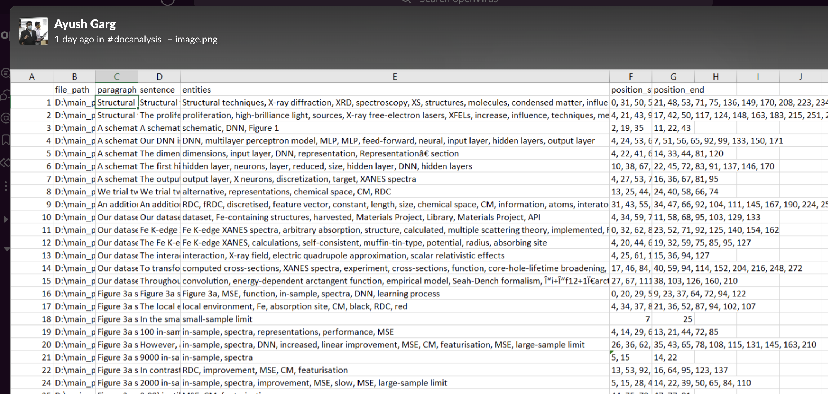
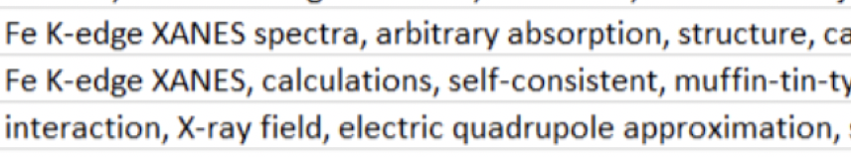
ScispaCy
Phrases
Location

Slide 12
docanalysis – count words and phrases automatically
10 random articles on X-ray spectroscopy
('NIB', 18), ('sXAS', 16), ('mRIXS', 15), ('Fe', 13),), ('MSE', 11 ('Mn', 9), ('Ti', 7), ('N', 7), ('Al', 7 ('XANES spectra', 6),
We collect these into dictionaries …
NIB: https://en.wikipedia.org/wiki/Neodymium_magnet
sXAS: https://en.wikipedia.org/wiki/X-ray_absorption_spectroscopy
mRIXS: https://en.wikipedia.org/wiki/Resonant_inelastic_X-ray_scattering
XANES: https://en.wikipedia.org/wiki/X-ray_absorption_near_edge_structure
Uses ScispaCy
Shweata N Hegde

Slide 13


Workflow
Download Literature
Search literature using dictionaries
Create Dictionaries
Create Dictionaries
SPARQL method
Link to Wikimedia
Prachi Singh
Notes:
This Photo by Unknown Author is licensed under CC BY-SA

Slide 14



Dictionary creation using Wikidata
ami dict
Dictionary
2021 - a sustainable future for Wikidata
This Photo by Unknown Author is licensed under CC BY-SA

Slide 15
SPARQL Query
https://w.wiki/4HEb
#diterpenes
SELECT ?item ?itemLabel
WHERE
{
?item wdt:P31 wd:Q59447. # instance of diterpene
SERVICE wikibase:label { bd:serviceParam wikibase:language "[AUTO_LANGUAGE],en". } # Helps get the label in your language, if not, then en language
}
2021 - a sustainable future for Wikidata

Slide 16
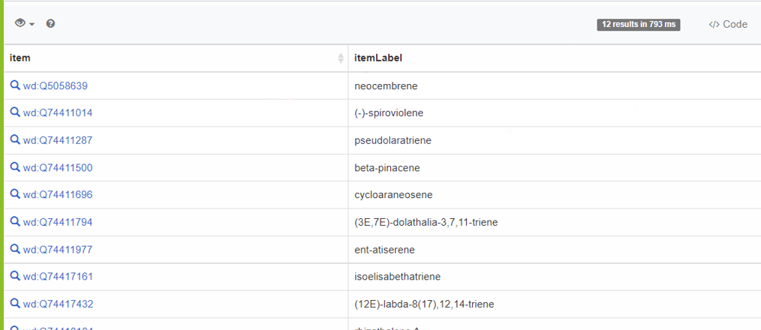
SPARQL Results
Results of SPARQL query

Slide 17
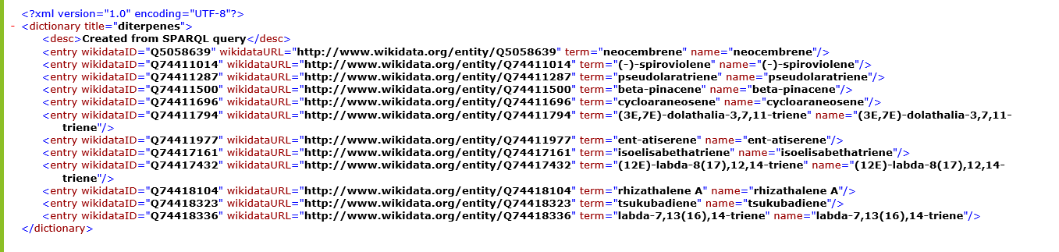
Final Dictionary!
Wikidata ID
Term
Ready to go off and annotate the scientific literature!
2021 - a sustainable future for Wikidata

Slide 18
Dictionary Entry
<entry term="cone“ wikidataURL="http://www.wikidata.org/entity/Q22710" wikidataID="Q22710" wikipediaPage="https://en.wikipedia.org/wiki/Conifer_cone">
<synonym>Cone, Conifer cones, Strobilus, pine cone, pine-cone, pinecone, pine cones</synonym>
<synonym xml:lang="zh">松球</synonym>
<synonym xml:lang="de">Koniferenzapfen</synonym>
<synonym xml:lang="hi">कोणधारी कोण</synonym>
<synonym xml:lang="es">cono</synonym>
<synonym xml:lang="fr">cône</synonym>
<description xml:lang="fr">organe reproducteur des conifères</description>
<description xml:lang="es">estructura vegetal</description>
</entry>
term
Multilingual entries
Credits: Vasant Kumar

Slide 19
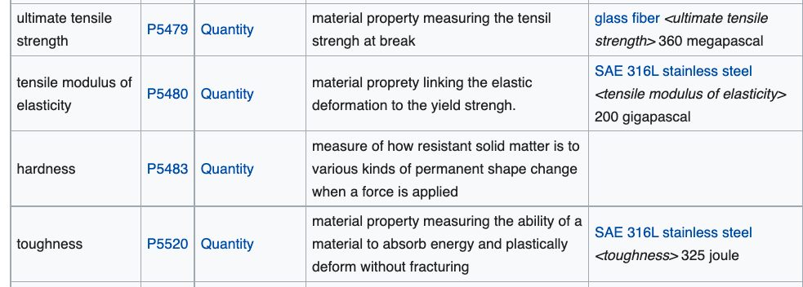
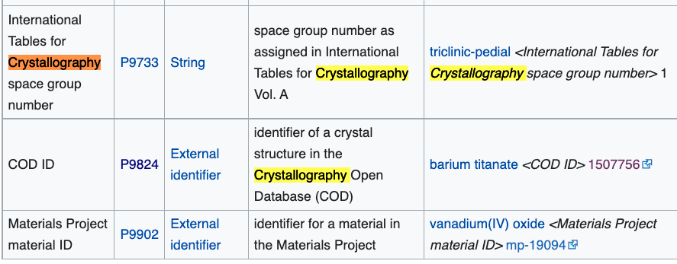
Examples of WikidataProperties for Materials Science

Slide 20
We make a simple dictionary for materials
HACK PROJECT
<dictionary title="materials">
<entry term="anode" wikipedia="anode" wikidata="Q181232" description="electrode through which conventional current flows into a polarized electrical device"/>
<entry term="cathode" wikidata="Q175233" description="electrode from which …"/>
<entry term="current density" wikidata="Q77680811”/> …

Slide 21
Search, annotation, mining

Slide 22
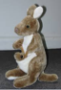
abstract
Captioned
Figures
methods
Fig. 1
MINING
with sections
and dictionaries
HTML tables
references
abstract
Captioned
Figures
Dict A
Fig. 1
Image
Caption
methods
HTML tables
Dict B
references
Table
Caption
[W3C Annotation / https://hypothes.is/ ]

Slide 23
Annotation using Dictionaries
file="liion/PMC4062906/methods/search/elements/results.xml">
<result pre="foil and dried at 80°C under vacuum for 5 h." exact="Lithium" post="sheet was served as counter and reference …"/>
methods = section
PMC4062906 = reference
elements = dictionary
(annotation to W3C spec)

Slide 24
Automatic extraction of plot data
Goal: to read millions of plots and automatically convert to CSV

Slide 25
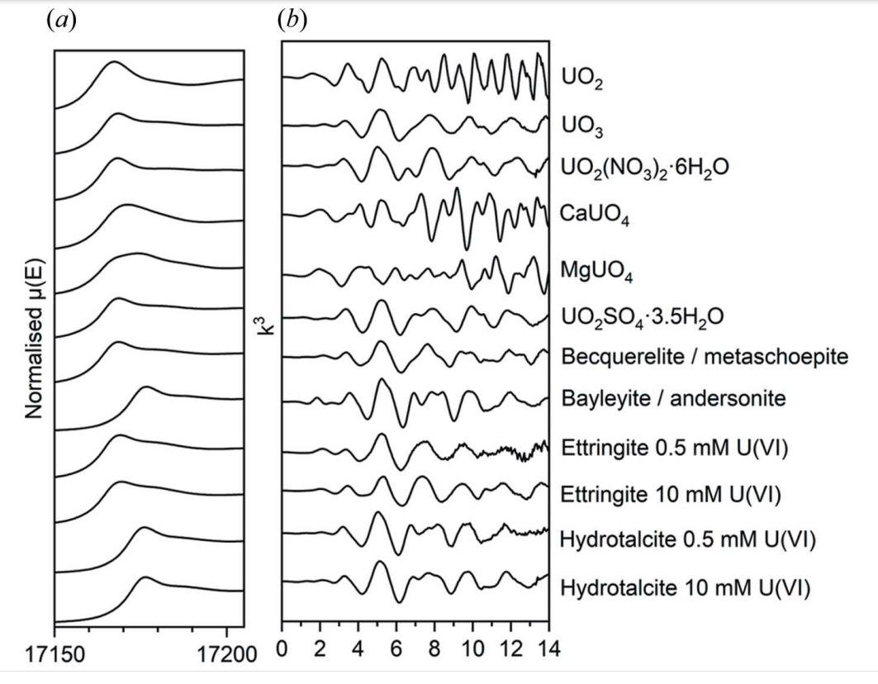
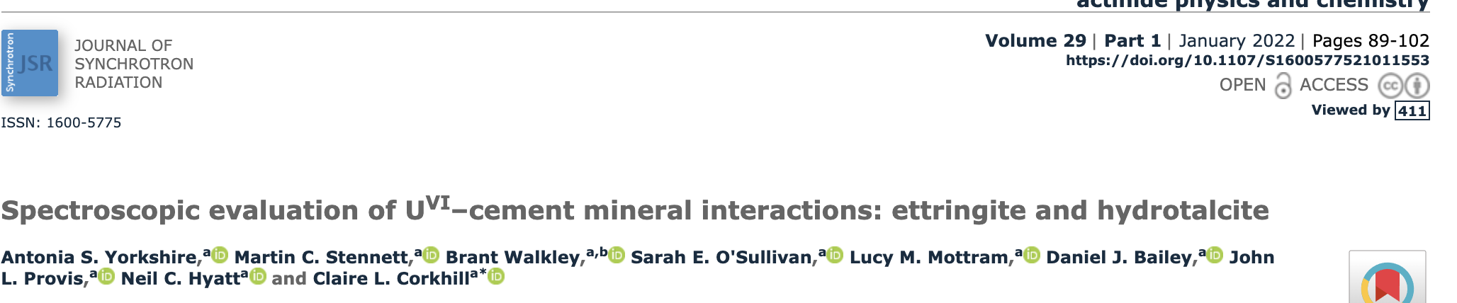
This can be automatically extracted into CSV files for each substance. HACK PROJECT

Slide 26
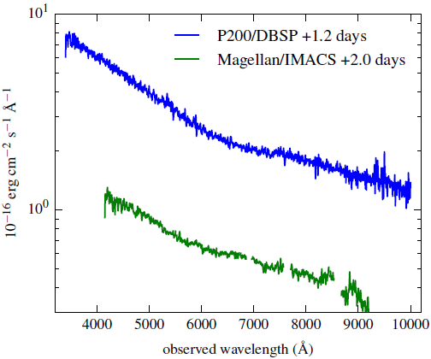
TITLES
VECTOR PDF
DATA!
2000+ points
UNITS
TICKS
SCALE
QUANTITY

Slide 27
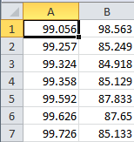
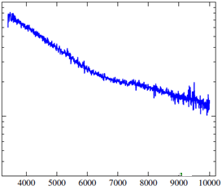
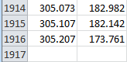
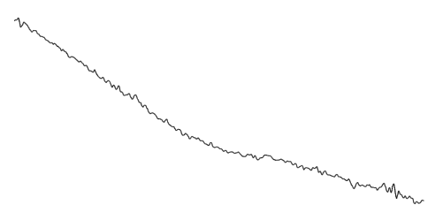
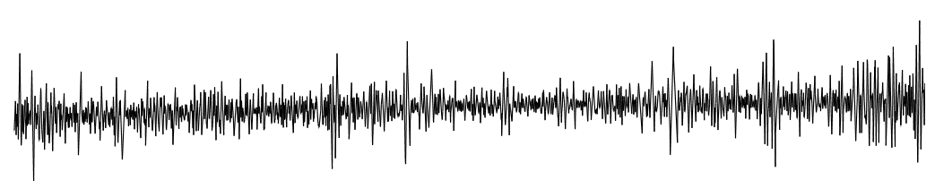
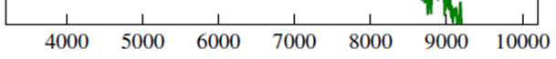
Dumb PDF
Automatic
extraction
CSV
Smoothing Gaussian Filter
Semantic
Spectrum
2nd Derivative

Slide 28
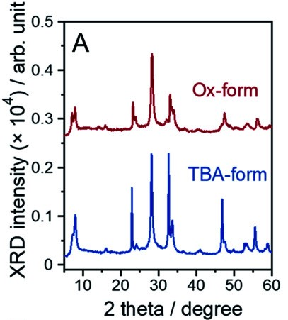

Label detection in plots
using AmiOCR
pyamiimage
Anubhab Chakraborty
Sample Image

Slide 29
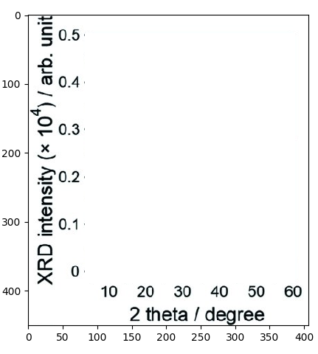
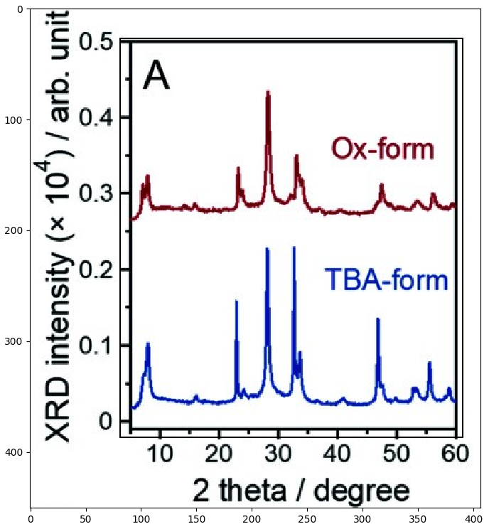
Plot removed to make OCR easier
OCR labels separately in Tesseract better accuracy

Slide 30
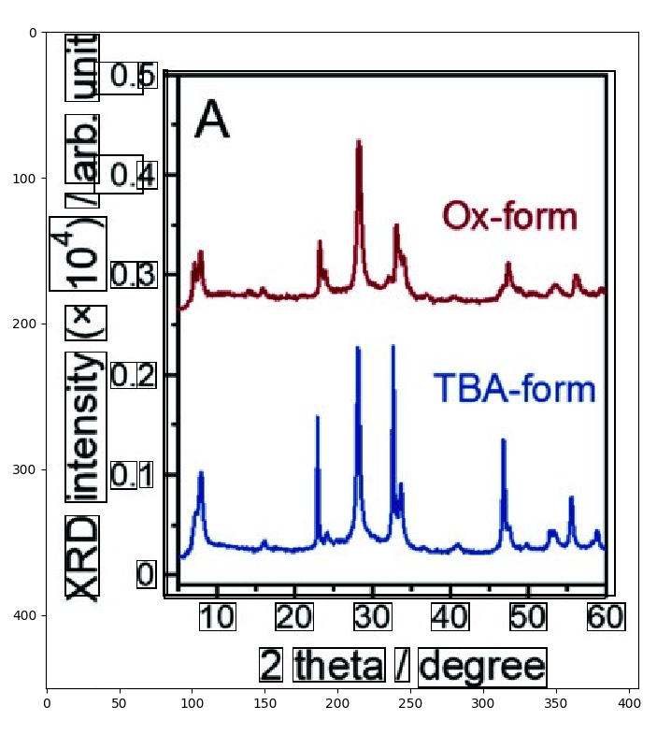
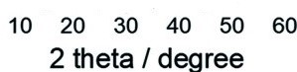
Detecting text in the plot helps us make an idea of what is going on in the plot.
It give us information about the scale of the axes from the value of ticks and the unit from the adjoining text
We can find the axis scale from the spine
Labels text and bounding boxes detected
HACK PROJECT: extract into CSV

Slide 31
This can be automatically extracted into CSV files for each substance. HACK PROJECT

Slide 32
Some immediate benefits
Semantic search
Data validation and variability
Knowledge aggregation and systematics
Knowledge prosthetics
New questions

Slide 33
Thanks:
NIPGR, Delhi for 11 interns
INYAS 5 interns
KARYA 4 interns
Wikimedia grant to ContentMine
https://github.com/petermr/openVirus viral epidemics
https://github.com/petermr/CEVOpen plant science
https://github.com/petermr/ami3 AMI Semantic framework
https://github.com/petermr/pyami Python AMI Semantic framework
https://github.com/petermr/pyamiimage Python Image mining
https://slideshare.com/petermurrayrust. Many talks

